Slide 1
CROP PRODUCTION

Slide 2
Introduction
The Agriculture business domain, as a vital part of the overall supply chain, is expected to highly evolve in the upcoming years via the developments, which are taking place on the side of the Future Internet. This paper presents a novel Business-to-Business collaboration platform from the agri-food sector perspective, which aims to facilitate the collaboration of numerous stakeholders belonging to associated business domains, in an effective and flexible manner.

Slide 3
Main KPIs
Total Crop Production Volume: The overall quantity of crops produced in a given year.
Yield per Hectare: The average production volume per unit area, indicating the efficiency of crop production.
Area Harvested: The total land area used for harvesting crops.
Crop Type Distribution: Breakdown of production volume and area harvested by different crop types.

Slide 4
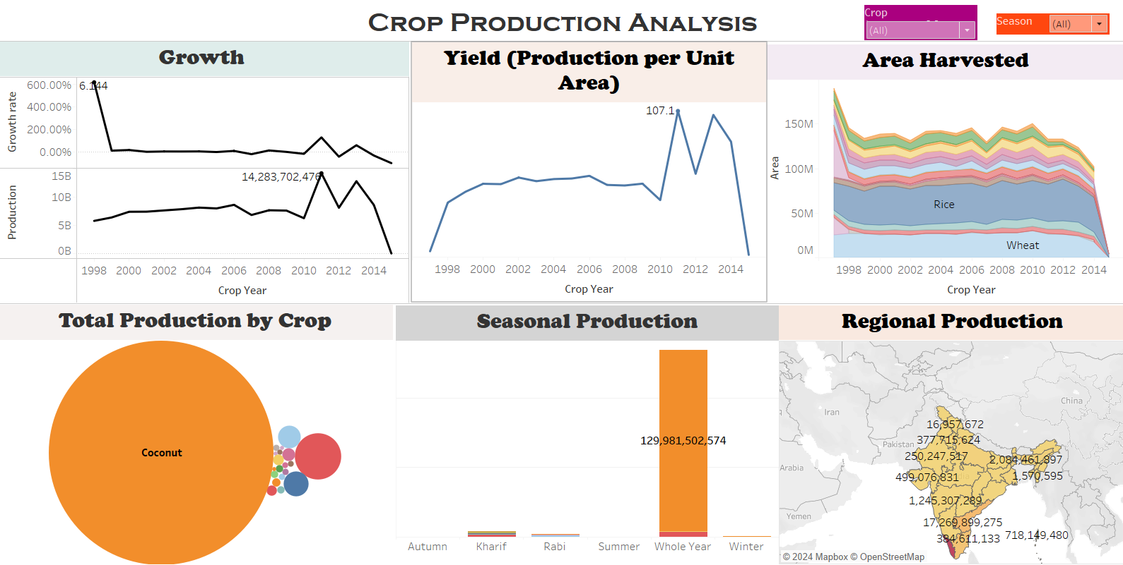
Dashboard

Slide 5
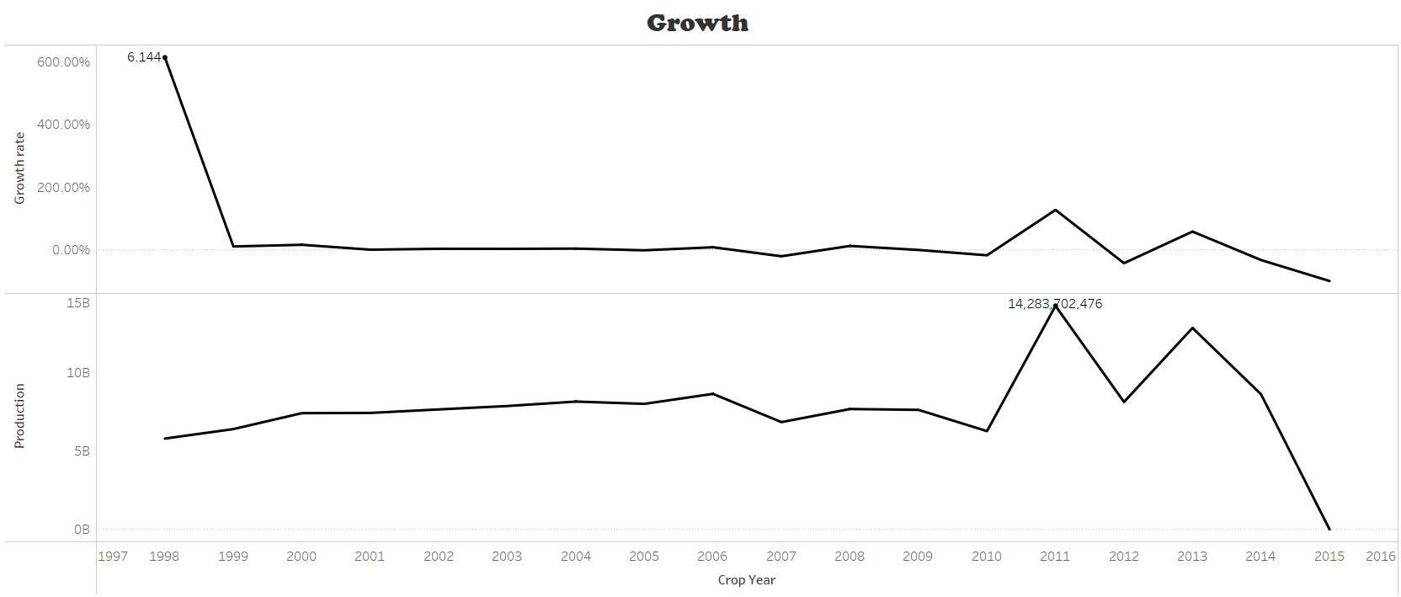
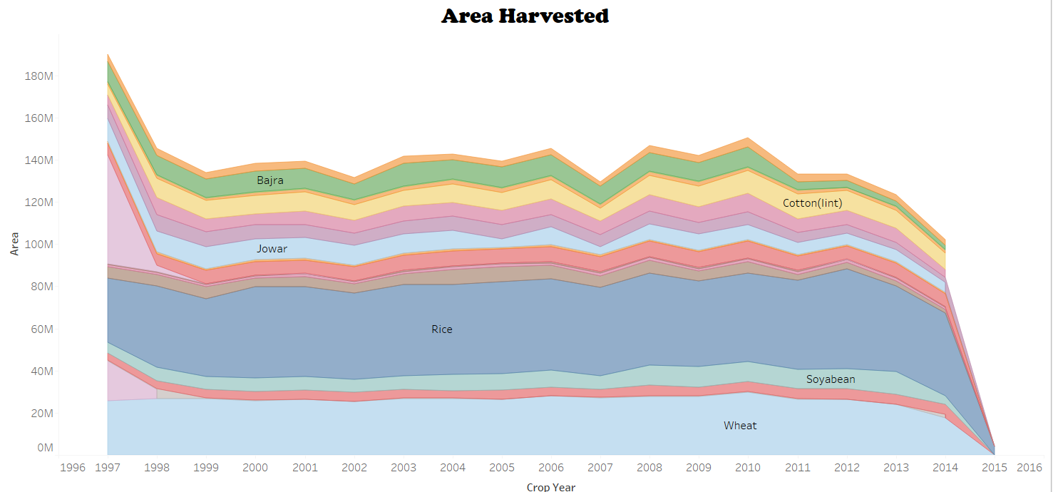
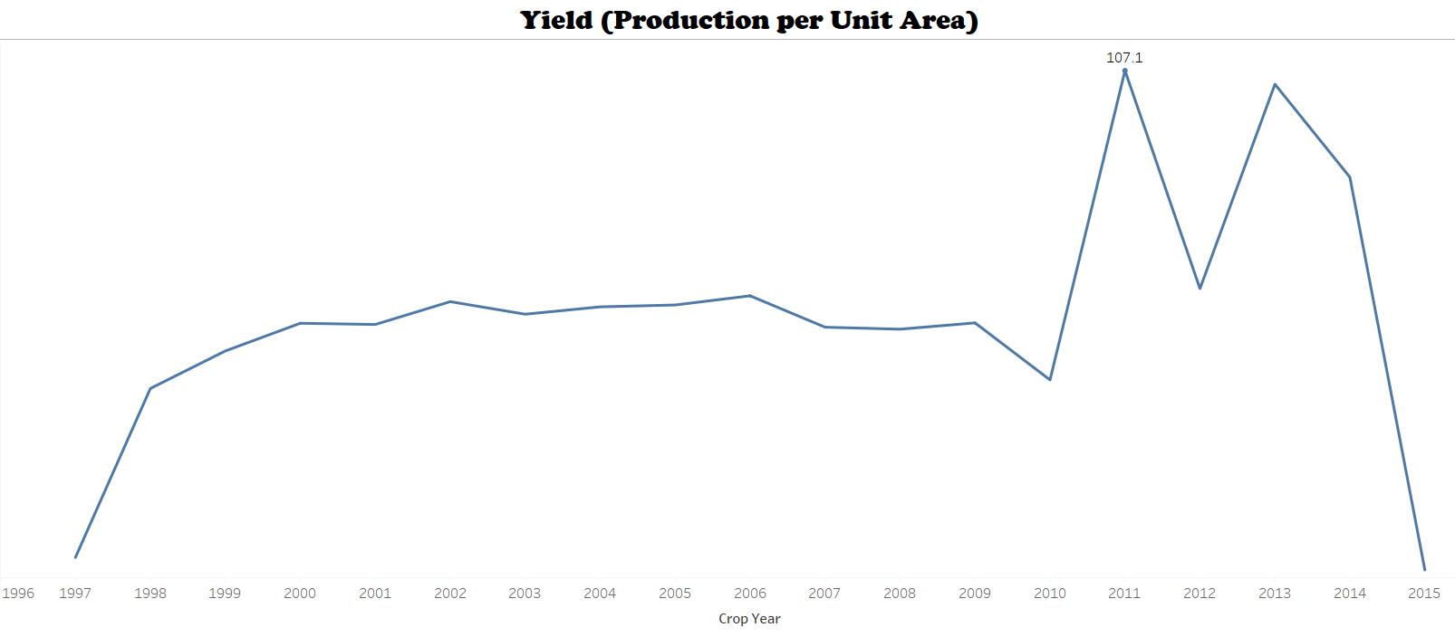
My designs

Slide 6
THANK YOU

